Slide 1
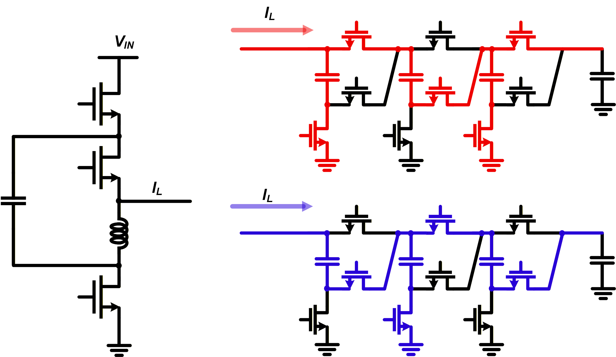
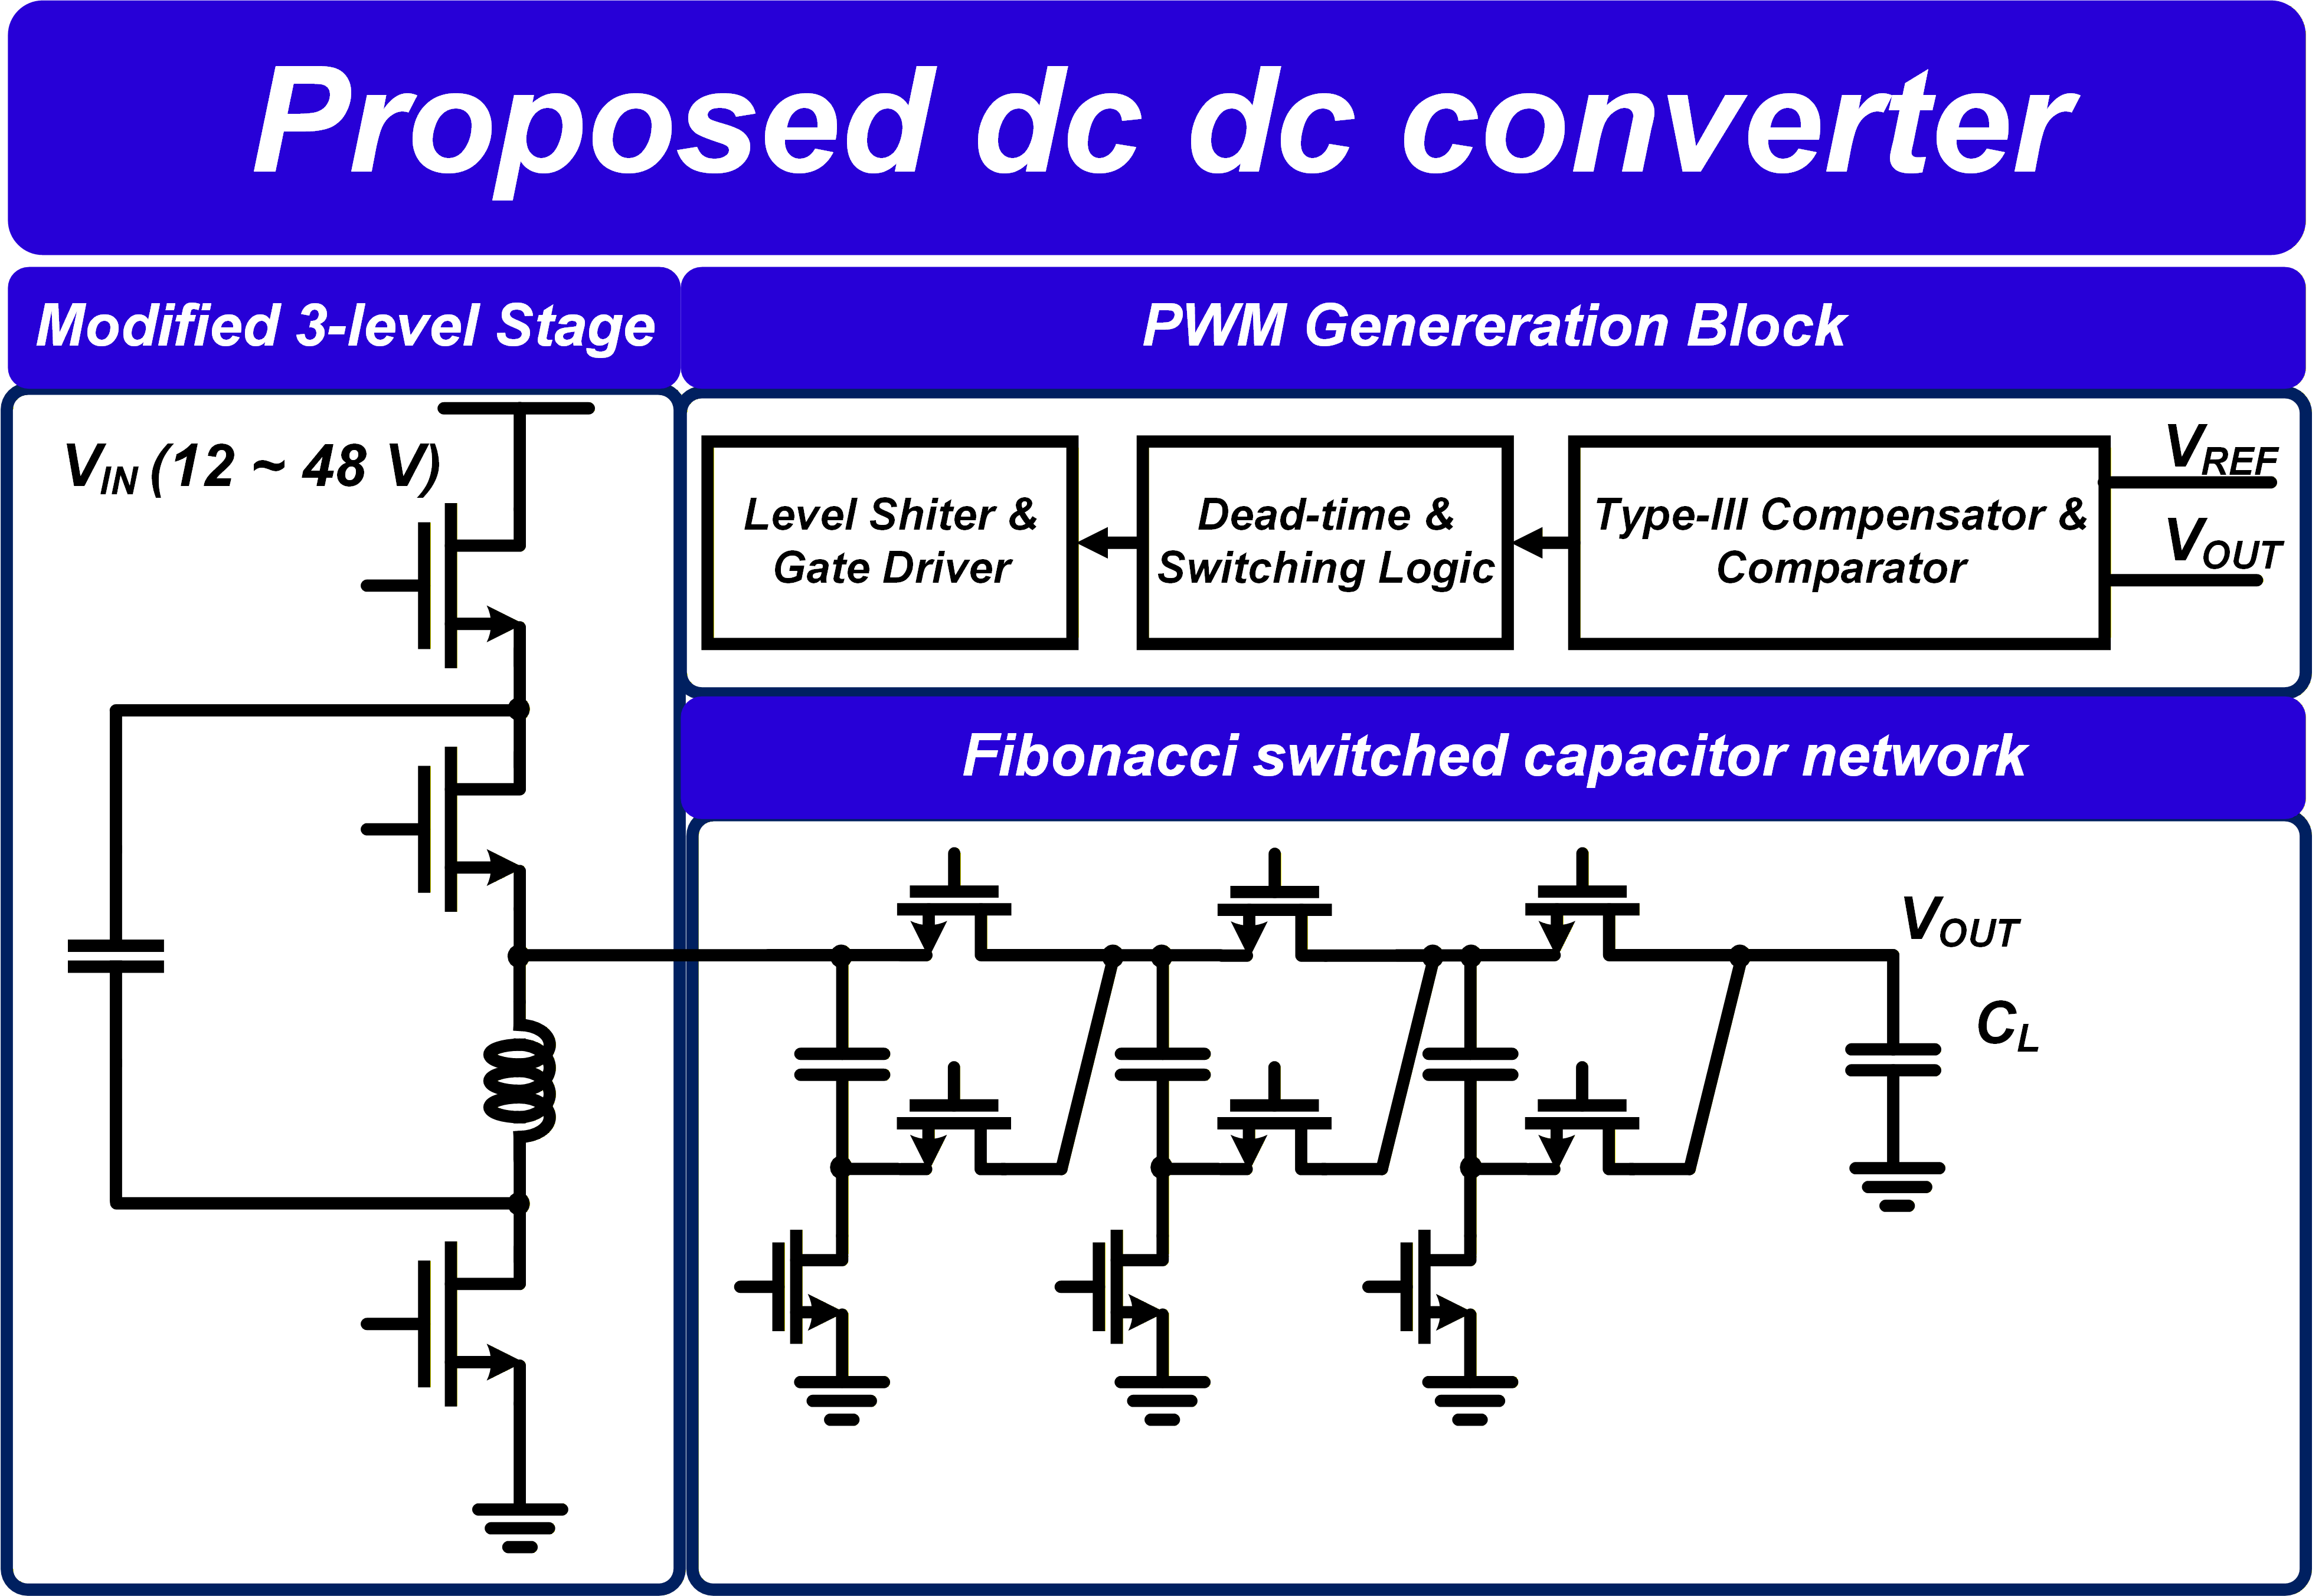
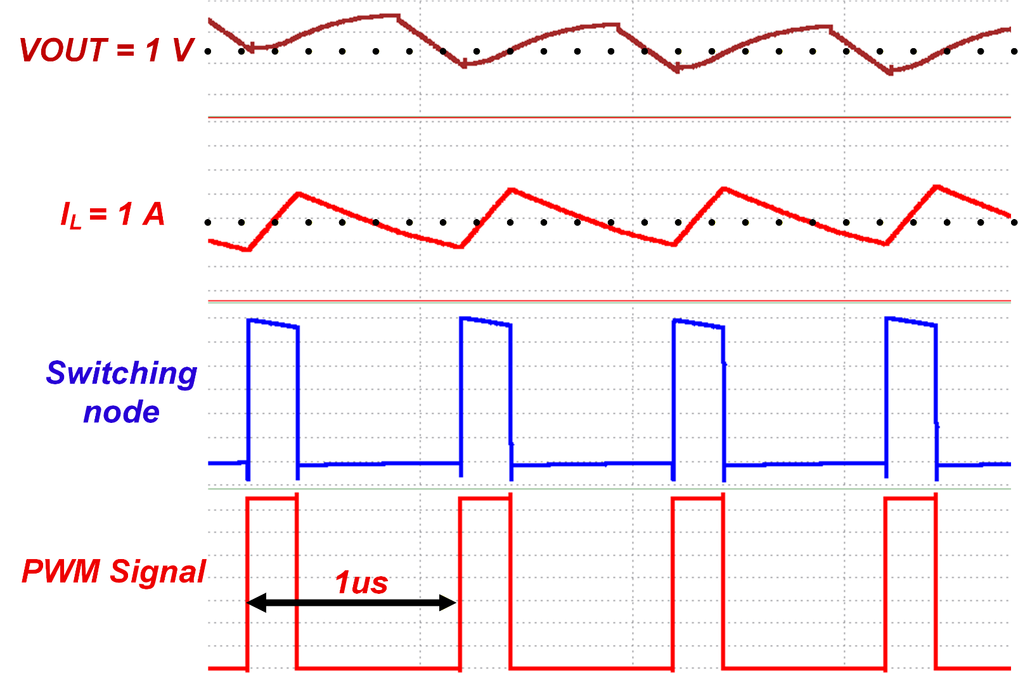
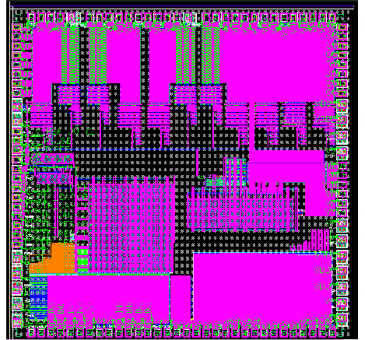
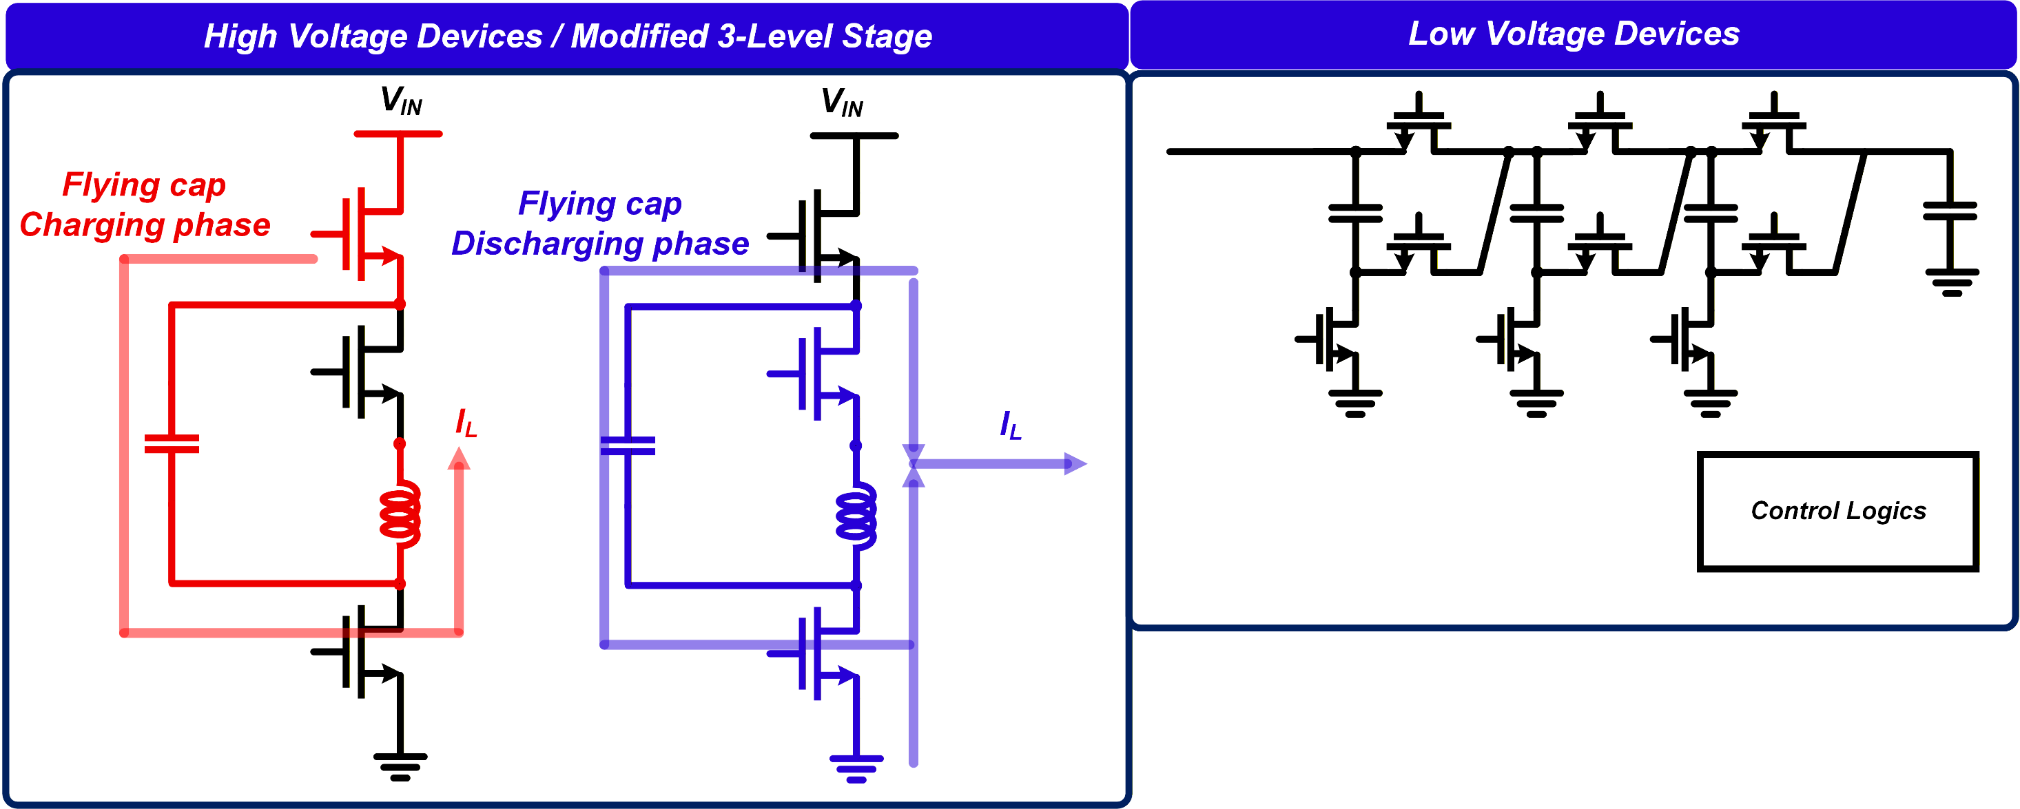
A Wide-VCR Buck DC-DC Converter Using 3-Level Current Regulation Cell and Fibonacci Switched-Capacitor Stage
Junseo An¹⁾ , Yongkeon Kwon²⁾, and Jun-Eun Park²⁾
¹⁾Department of Semiconductor and Display Engineering, ²⁾ Department of Electrical and Computer Engineering, Sungkyunkwan University, Suwon, Republic of Korea
Abstract
Fibonacci SC Stage
As power demands continue to grow, DC-DC buck converters are increasingly required to handle input voltages well beyond the conventional 12 V range. The proposed converter employs a modified 3-level structure as a current regulation cell, controlling inductor current while distributing voltage stress across switching devices. The regulated current is then fed into a Fibonacci-based switched-capacitor stage that performs multi-ratio voltage step-down with low ripple. The design is implemented in a 130-nm BCDMOS process, targeting wide-VCR point-of-load applications from high-voltage inputs.
• The regulated current is fed into a Fibonacci-based switched-capacitor network that performs multi-ratio voltage step-down. By arranging capacitors according to Fibonacci scaling, each stage handles a smaller voltage, achieving a wide voltage conversion ratio while maintaining low output ripple without increasing passive component size.
Proposed Design
• The proposed DC-DC converter consists of a modified 3-level current regulation stage followed by a Fibonacci-based switched-capacitor stage, enabling wide voltage conversion ratio from high-voltage inputs. The two-stage architecture separates the roles of current regulation and voltage step-down, achieving both low switch voltage stress and low output ripple within a compact mixed-signal implementation in a 130-nm BCDMOS process.
Simulations Results
• The proposed converter was verified through transistor-level simulations under a 12-V input, 1-V output condition at a 1-MHz switching frequency
•The chip layout is implemented in 130-nm BCDMOS with a total area of 3.55 × 3.55 mm².
Modified 3-level Buck Topology
Conclusions
• Modified 3-level buck topology in which a flying capacitor clamps the voltage stress across each switching device, enabling reliable high-voltage operation.
• The inductor is utilized as a current regulation element, smoothing the switching current and providing stable, controlled current delivery to the Fibonacci SC stage.
A wide-VCR DC-DC buck converter combining a modified 3-level current regulation cell and a Fibonacci SC stage has been presented, targeting high-voltage point-of-load applications in data-center and automotive systems. The proposed architecture achieves low switch voltage stress through flying capacitor clamping and wide conversion ratio through Fibonacci-based step-down, demonstrating a compact and efficient power delivery solution for next-generation high-voltage PoL systems.
Acknowledgement
The chip fabrication and EDA tool were supported by the IC Design Education Center(IDEC), Korea.

